Slide 1
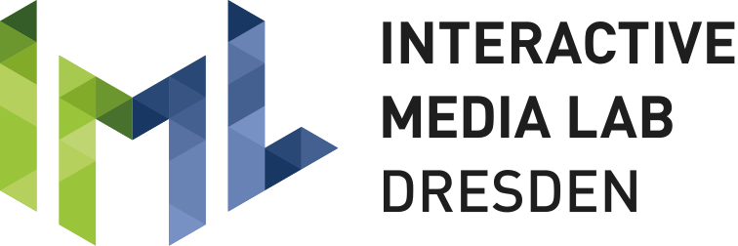
Human-Pose Prediction for Low-Latency Mixed-Presence Collaboration
Master’s Thesis
Interactive Media Lab Dresden
Institute of Software and Multimedia Technology
Presenter : Divyendu Dutta
Supervisor : Dr.-Ing. Wolfgang Büschel
13.01.2025

Slide 2
Introduction

Slide 3

Context
MPC bridges co-present and remote collaboration
Crucial for HCI to analyze collaboration dynamics
MPC systems face challenges such as:
Display Disparity : Differing devices create fragmented perspectives
Presence Disparity : Co-located participants feel a stronger sense of presence than remote
collaborators
[1]
Notes:
With the growing accessibility of advanced technologies

Slide 4
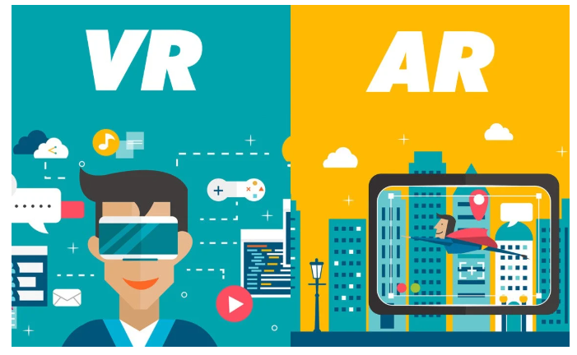
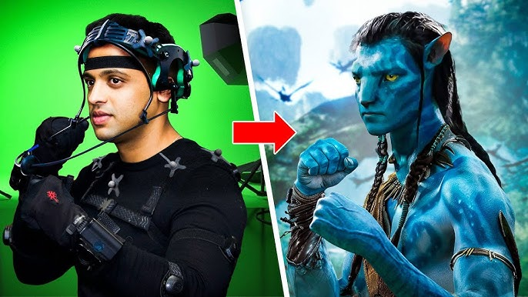
Context
AR/VR can address presence disparity
Creates shared virtual spaces for collaboration
Enhances presence, engagement, and unity
[2]
Live motion tracking enables immersion
Captures gestures and physical presence
[3]
Notes:
Now, the use of immersive displays, such as augmented reality (AR) and virtual reality (VR),
AR/VR can create a shared virtual space fostering a deeper sense of presence and engagement.
One critical technology that enables this immersive experience

Slide 5
Problem Description and Motivation
Accurate and responsive motion tracking is challenging because of inherent latency
Causes various issues such as out of sync motions etc
Reduces presence, embodiment, and collaboration effectiveness
Motivation : Addressing latency in MPC systems
Integrate human pose prediction models to enhance responsiveness
Bridge MPC and pose prediction
Notes:
Despite the advantages of MPC systems, a critical challenge lies
Motion tracking systems often suffer from inherent latency. And this is further amplified
This ultimately reduces

Slide 6
Background and Related Work
Notes:
Next I will briefly provide some of the relevant background and related work.

Slide 7
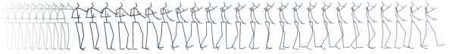
Short-Term Human Pose Prediction
Humans navigate by predicting others' actions; machines use 3D human pose prediction for this
Predicting future movement poses given past motion poses
Seed Sequence
Target Sequence
Short Term
Pose Prediction
Generative Modelling Task
Long Term

Slide 8
Overview of Various Human Pose Prediction Models
Recurrent neural networks (RNNs) preferred for human pose prediction
RNNs struggle with long- and short-term predictions [4]
Graph convolutional network (GCN) used for human motion prediction [5, 6, 7]
Two-network GCN system: spatial and temporal [8]
Universal Graph Convolution: a unified framework that integrates various GCN designs [9]
Transformer models used for human pose prediction, inspired by their success in text generation [10, 11, 12]
Notes:
Next I would like to provide a short summary of
Traditionally, recurrent neural networks (RNNs) have been widely preferred
But Martinez and colleagues show via empirical evidence that prevailing RNNs
Previous works have also utilized a graph convolutional network
Ma and colleagues propose a two-network system consisting
Wang and colleagues take GCNs for human pose prediction to the next step. They propose "Universal Graph Convolution (UniGC)“
More recently, various works have also utilized the transformer architecture

Slide 9
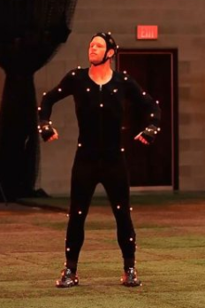

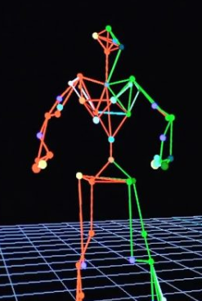
Latency Challenge in Live Human Motion Tracking
Tracking data includes orientations and joint positions
Network latency worsens MPC delays
Delay
Tracking
Visualization
Notes:
Next lets look at the latency challenge inherent in live human motion tracking.
Motion tracking sensors introduce a notable delay
Typically, this data arrives to us in the form
In MPC systems, which rely on distributed architectures

Slide 10
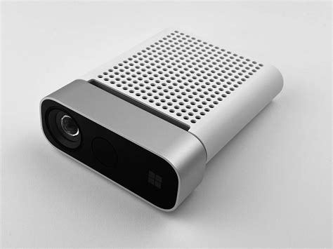
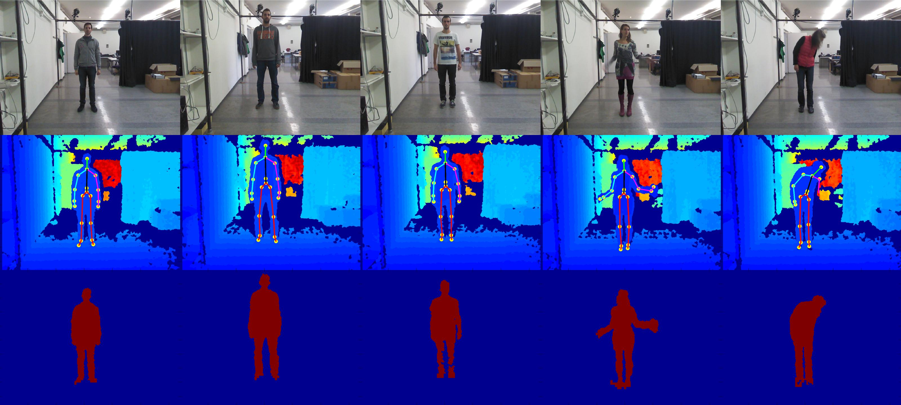
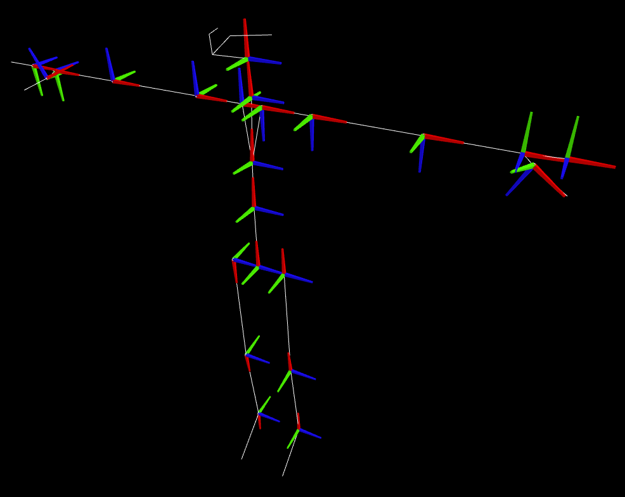
Potential Solutions to Mitigate Latency in Motion Tracking
Extract raw Kinect data, process orientations and positions on GPU
Proposed by Amamra et. al. [13]
Complex custom solutions and involve a lot of steps
No longer able to use the Kinect Body Tracking SDK
Networking delay still present
3D pose prediction can combat latency
Kinect
Raw RGBD Data
Human Pose
Notes:
To address the latency associated with Kinect sensors specifically, one potential solution involves
However, this approach is highly complex,
Additionally, implementing such custom solutions gives
Another solution is to utilize the previously mentioned 3D human pose prediction models

Slide 11
Architectural Design and Implementation Details
Notes:
Next I will talk about the important elements and practical execution of integrating

Slide 12
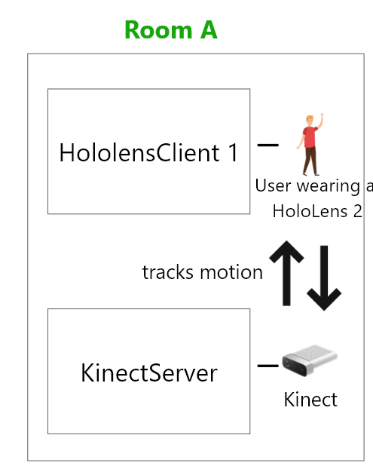
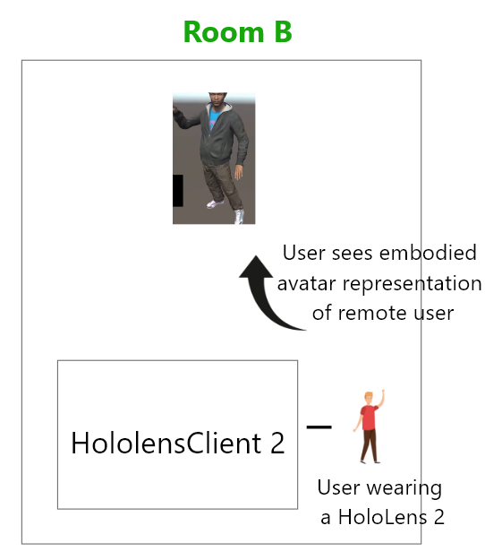
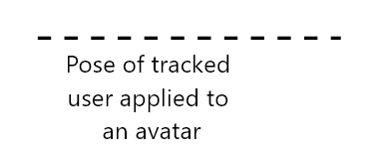
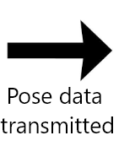
Minimal Version of the Existing MPC System
Notes:
So first, I provide an overview of the existing MPC system
The existing mixed presence collaboration system focuses on enabling co-located and remote participants to collaborate in a shared space.
In the most minimalistic sense for our purpose, there are
As we can see in the image, the KinectServer tracks the motion of a user (HololensClient 1) in "Room A“
This setup allows the local participant to experience the

Slide 13
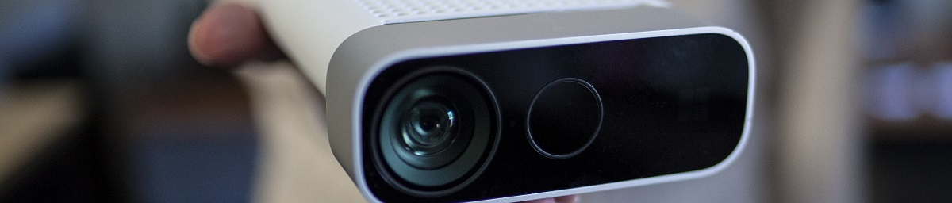
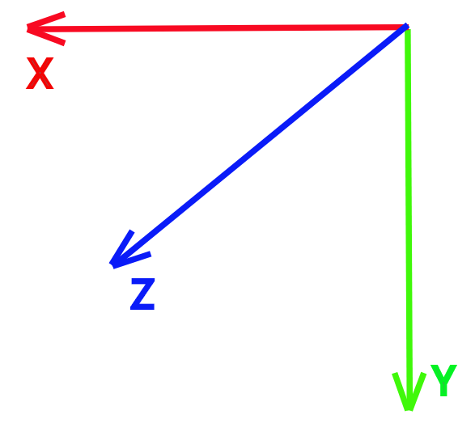
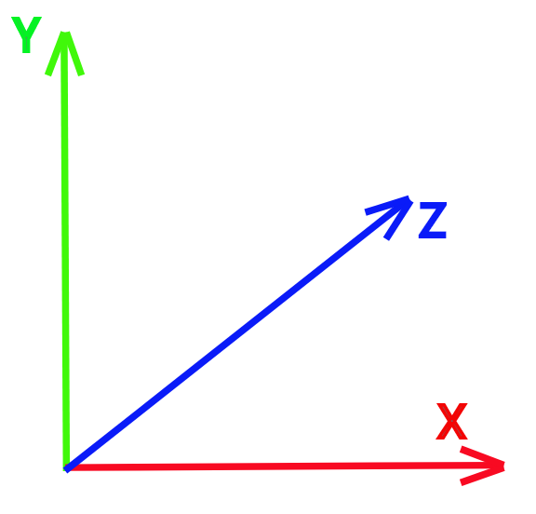
Overview of the Kinect Sensor
Body Tracking SDK provides joints' positions and orientations.
Color Camera
Depth Camera
[14]
Kinect Axes Orientation
Unity Axes Orientation
Notes:
The system uses the Microsoft Kinect to track and
The Azure Kinect Sensor is a motion-tracking device developed by Microsoft. It utilizes a depth
Specifically, the Body Tracking SDK provides the joint positions and orientations
This coordinate system's XYZ axes are oriented as shown
And finally, latency in the body tracking sdk is mainly introduced during data processing, which converts raw sensor input into skeletal and pose data.

Slide 14
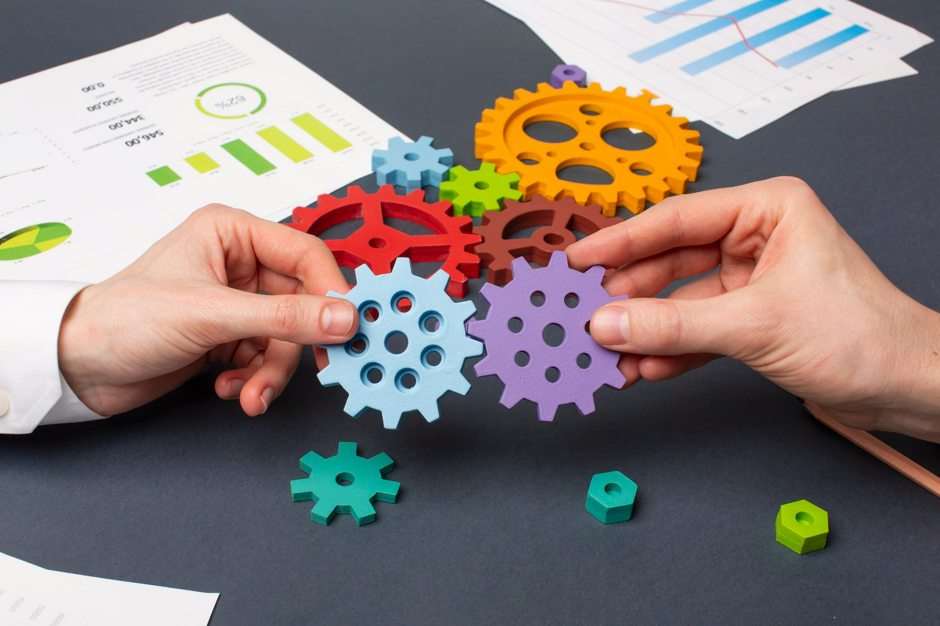
Pose Data Recording and Replay for Study Replicability
Solution
Tracked pose data from the Kinect is saved and used to mimic the sensor
Enables playback of recorded motions for repeatable testing
Working with Kinect is challenging due to time-
consuming debugging and variability in pose
data
Notes:
One of the key challenges of working with motion-tracking sensors, such as
The process becomes even more
Additionally, since the Kinect’s pose data
Hence, to enhance the testing and study replicability of the system, a mechanism
This data is then used in a custom class

Slide 15
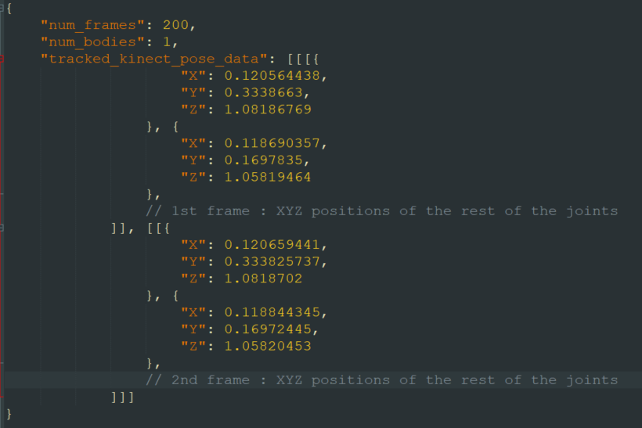
Pose Data Recording and Replay for Study Replicability
What kind of data is recorded?
200 frames:
200 * (1000/30) ms
= ~6.7s of motion
Notes:
So how does the saved pose data look like? Basically, the positions
These positions are in meters.
And The exact number of frames to save is configurable
So For example, if 200 frames are saved,

Slide 16
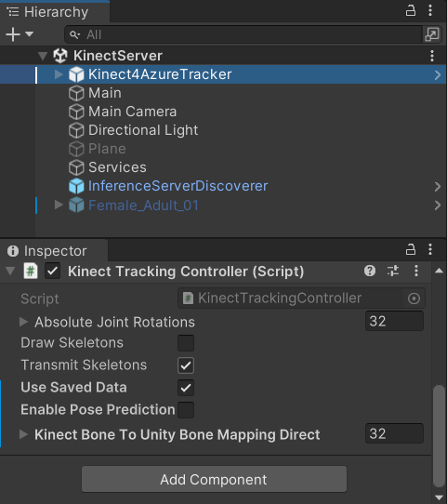
Pose Data Recording and Replay for Study Replicability
Here's how it looks like!
Notes:
Once a motion is recorded, it can replayed by the "KinectServer" component
Doing so now reads the saved human pose data
It does so frame by frame for all bodies
A 33ms delay is introduced
And here's how a sample motion sequence

Slide 17
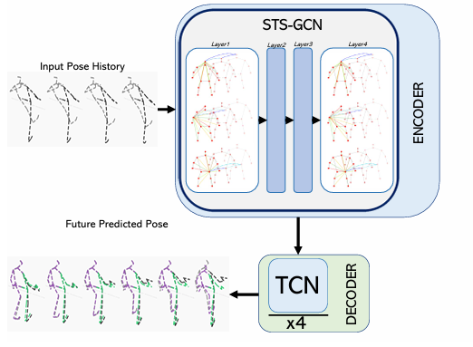
Overview of the STS-GCN Model
Prior work shows STS-GCN[15] offers fast inference and competitive accuracy[16]
Combines temporal and spatial joint dynamics
UnPOSed model trained on AMASS; tracks 18 joint positions in mm[17]
[15]
Notes:
Next I briefly cover the key aspects of the specific pose prediction model chosen
Previous work done in my research project to evaluate various 3D human pose prediction models
This makes it suitable for real-time applications.
It integrates both the temporal evolution of body pose and spatial joint interactions into a unified framework.
Furthermore, UnPOSed’s implementation of the model was utilized
Un-POSed provides an open-source framework for
The model was trained using the AMASS dataset which unifies
As per this dataset the human pose is represented by the xyz positions

Slide 18
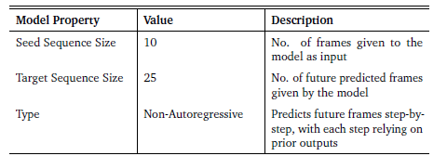
Overview of the STS-GCN Model
No. of frames given to the model as input
No. of future predicted frames given by the model
Predicts a specific number of frames in one go, ie. in
parallel
Relevant key aspects of the STS-GCN model
Notes:
This table outlines the key aspects
Such models predict future frames step by step with each step relying on the previous outputs.

Slide 19
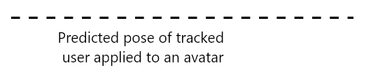
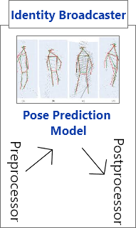
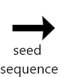
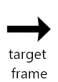

End To End Architecture
Notes:
Now lets look into how the pose prediction model is brought
So the existing MPC system looks like this as we've seen before.
Now, instead of the pose data being
Both the "KinectServer" and "HololensClient" act as
The inference server announces its presence and identity (ie,
On their end, these
The "KinectServer" was chosen to transmit

Slide 20
Inference Server for Pose Prediction
Identity Broadcaster shares server IP and port for communication setup
Pose Prediction Model is the core computational component
Preprocessor/Postprocessor adapt data for Kinect, model, and Unity.
Notes:
Next lets look at the parts of the inference server in more detail.
The inference server has the following parts:
As we can see, the design of the inference server is structured
As mentioned previously, the inference server’s identity broadcaster broadcasts
This allows the "KinectServer" and the "HololensClient" to determine
The 3D human pose prediction model ie, the STS-GCN model that I talked about earlier
It processes the input seed sequence
The preprocessor and postprocessor convert between the Kinect’s data

Slide 21
Detailed Workflow
Kinect : 30 fps <-> 33 ms
Assume total latency = 4 x 33 ms = 132 ms
When frame
occurred in reality
process repeats
latency eliminated
1
2
3
4
5
6
7
8
9
10
11
12
13
14
15
16
17
18
19
When frame is
available to us
9
10
15
16
1
2
3
4
5
6
7
8
11
New Seed Sequence
Seed Sequence
Notes:
To understand how the complete system functions and how its various parts
The Kinect tracks motion at a framerate of 30fps, equating to a
For the sake of simplicity let’s assume the MPC system has
So each frame that occurs in
The "KinectServer" tracks the motion of a user and composes a batch
The inference server preprocesses the data and sends
A specific frame, selected based on the overall MPC system’s latency considerations.
This frame is postprocessed and transmitted to the "HololensClient". The "HololensClient" can then utilize the provided frame to animate the remote avatar without noticeable lag.
As new frames are tracked by the "KinectServer," the oldest frame in the seed sequence is replaced with the latest one, creating a new seed sequence for the next prediction cycle.
This process repeats, allowing the inference server to effectively act as an intermediary, seamlessly supplying frames to the "HololensClient,".
I will provide a quick demo of the complete working system at the end of this talk.

Slide 22
Results
Notes:
Next lets look at the results derived from the integration and evaluation of the pose prediction model within the existing MPC system.

Slide 23
How was Model Comparison and Precision Evaluation Done?
Zero-Velocity Baseline
Pose Prediction Model
Ground Truth
Qualitative
Live Tracked Data
Evaluation
Quantitative
Pre-recorded Motions
Notes:
The pose prediction model was evaluated against two baselines
Zero-velocity predictions serve as a simple baseline where
This evaluation was conducted through both qualitatively and quantitatively.
Furthermore, the comparison was carried out for two different data sources:

Slide 24
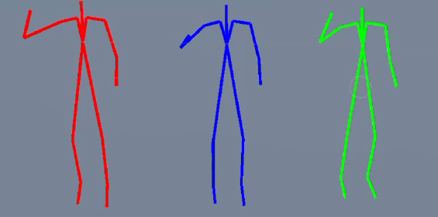
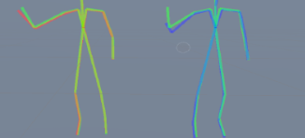
How was Model Comparison and Precision Evaluation Done?
Side By Side Comparison
Superimposed Comparison
Zero-Velocity
Pose Prediction Model
Ground Truth
Zero-Velocity
<->
Ground Truth
Pose Prediction Model
<->
Ground Truth
Displacement error = The average Euclidean distance over all the joints
Notes:
For qualitative comparison, The visualization is done side by side as we can see.
Here the ground truth pose is displayed in green,
The comparison is Also done via superimposed format where the predicted poses of
This approach provides more clarity.
Next onto precision evaluation. Based on the existing literature, the most commonly used evaluation metric for pose precision is displacement error. It is the average euclidean distance over all the joints.

Slide 25
Qualitative Comparison
Jitteriness in the pose prediction model’s predicted poses (blue stickfigure)
Inconsistencies may stem from overfitting or poor generalization to real-world data
Notes:
here we can see them compared side by side.
An immediate and noticeable distinction between them is the jitteriness observed in the visualization of the pose prediction model’s predicted poses.
Its a little hard to see here

Slide 26
Qualitative Comparison
Pose prediction model underperforms compared to baseline
Notes:
And here we can see the superimposed comparison.
Here visually, it is evident that the pose prediction model falls short when compared to the baseline.

Slide 27
Quantitative Comparison – Precision Evaluation
Pose save and replay feature used to record motion sequences
Motion sequences exhibit diverse movement intensity and dynamics
Recorded motion sequences are:
Slowly waving one hand
Quickly waving both hands
Quickly running. This engages most of the joints of the body
Computed displacement error averaged over 200 frames
The 5th frame from predicted target sequence selected for evaluation
Notes:
Next moving onto quantitative comparison.
The pose save and replay feature previously mentioned was used to capture
Three distinct motion sequences were recorded, carefully selected to encompass a diverse range of movements.
For all these motions sequences the displacement errors were computed relative to the ground truth averaged over 200 frames.
The 5th frame from the target sequence was selected as a representative case for evaluation. Consequently, the reported errors may vary if an earlier or later frame is chosen. However, this serves as a suitable general evaluation.

Slide 28
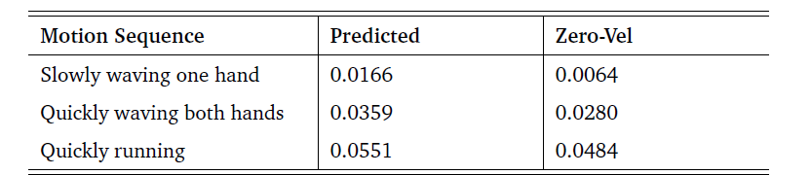
Quantitative Comparison – Precision Evaluation
Lower error is better, more accurate
Model underperforms compared to zero-velocity baseline across sequences
Pose prediction model shows potential but needs optimization
Average displacement error over 200 frames in meters (m).
Notes:
The results are summarized in this table.
So lower error is better, more accurate.
Here Predicted is the
As we saw visually as well, The average displacement errors reveal
But something interesting to note is that, Although the pose prediction model consistently performs worse than the zero-velocity baseline model, the baseline model’s error rate increases dramatically as the complexity and speed of the motion grows.
This indicates that the pose prediction model has the potential to handle more dynamic motions, although it needs further optimization to better match the accuracy of the zero-velocity model.

Slide 29
Conclusion
Notes:
Finally I would like to conclude by summarizing the key results and insights gained, offering a deeper understanding of the implications of the work and then the potential future work.

Slide 30
Key Findings and Insights
STS-GCN functional but imprecise: Requires finetuning for dynamic motions
Local vs global pose prediction
Verify model’s joint compatibility to ensure outputs suffice for avatar animation
Proper preprocessing very important
Input-output representation impacts system design
Notes:
So This thesis focused on the integration of a 3D human pose prediction model
While the chosen pose prediction model was functional, its precision fell short when compared to the zero-velocity baseline. This highlighted the need for further finetuning of the pose prediction model to better handle dynamic and complex motion sequences.
Furthermore, This work highlighted several important considerations for successfully integrating a pose prediction model with live-tracked motion data in a real-time environment.
One major insight is the distinction between local and global pose prediction. While local pose prediction focuses on the relative movements of joints without accounting for spatial translation, global pose prediction extends this to include movement through space. I will talk a little more about it in the next slide.
Another consideration is the compatibility of the model’s joint outputs for animating avatars. It is important to verify whether the predicted joints are sufficient for driving an avatar’s animation or if additional computation is needed to fill in missing joints.
Finally, the type of input and output representation used by the model has significant implications for system design. For eg, if the model outputs positions or orientations of the joints.

Slide 31
Limitations and Future Work
Limited to local pose prediction; future work can explore global pose prediction
models
Support the existing MPC system in its full scale
Validate latency reduction with complete configuration
Notes:
Next lets look at the limitations of the integrated system and how it can be improved in the future.
This version of the integrated system incorporates the STS-GCN model as its core pose prediction component. However, the model is limited to predicting local poses, which excludes spatial translations. Future work could explore benchmarking models capable of global pose prediction. An alternative approach would involve retraining the STS-GCN model using datasets that retain global positions, thereby enabling it to predict spatial translations.
Expanding the capabilities of the inference server is another area for future development. By supporting multiple "HololensClient" and "KinectServer" components, the system could align with the full-scale requirements of the existing MPC system.
Finally, The integrated system is designed to theoretically reduce latency in the MPC system. However, this claim has not been empirically validated. Establishing and testing the system with a complete configuration would provide concrete evidence of its latency reduction potential.

Slide 32
Thank You Demo and QnA
Notes:
Thank you all for your attention and now I'd like to provide a short live demo of the complete working system and then we can move onto QnA.

Slide 33
References
[1] https://www.cbre.com/insights/articles/mixed-presence-collaboration-key-to-successful-hybrid-work
[2] https://www.robotlab.com/blog/what-is-the-difference-between-ar-and-vr
[3] I Tried $10,000 Hollywood Motion Capture Suit | https://www.youtube.com/watch?v=AIRJqmm0eqE
[4] Julieta Martinez, Michael J. Black, and Javier Romero. On human motion prediction using recurrent neural networks. Proceedings IEEE Conference
on Computer Vision and Pattern Recognition (CVPR) 2017, July 2017, pp. 4674–4683
[5] Wei Mao, Miaomiao Liu, Mathieu Salzmann, and Hongdong Li. Learning Trajectory Dependencies for Human Motion Prediction. Proceedings of
the IEEE/CVF International Conference on Computer Vision (ICCV), Oct. 2019
[6] Theodoros Sofianos, Alessio Sampieri, Luca Franco, and Fabio Galasso. Space-Time-Separable Graph Convolutional Network for Pose
Forecasting. Proceedings of the IEEE/CVF International Conference on Computer Vision (ICCV), 2021
[7] Lingwei Dang, Yongwei Nie, Chengjiang Long, Qing Zhang, and Guiqing Li. MSR-GCN: Multi-Scale Residual Graph Convolution Networks for
Human Motion Prediction. Proceedings of the IEEE/CVF International Conference on Computer Vision (ICCV), Oct. 2021, pp. 11467–11476
[8] T. Ma, Y. Nie, C. Long, Q. Zhang, and G. Li. Progressively Generating Better Initial Guesses Towards Next Stages for High-Quality Human Motion
Prediction. 2022 IEEE/CVF Conference on Computer Vision and Pattern Recognition (CVPR), June 2022, pp. 6427–6436
[9] Xinshun Wang, Qiongjie Cui, Chen Chen, and Mengyuan Liu. GCNext: Towards the Unity of Graph Convolutions for Human Motion Prediction.
2023. arXiv: 2312.11850 [cs.CV]
[10] Emre Aksan, Manuel Kaufmann, Peng Cao, and Otmar Hilliges. A Spatiotemporal Transformer for 3D Human Motion Prediction. 2021
International Conference on 3D Vision (3DV), Dec. 2021, pp. 565–574
[11] Saeed Saadatnejad, Mehrshad Mirmohammadi, Matin Daghyani, et al. Toward Reliable Human Pose Forecasting with Uncertainty. 2023
[12] Angel Martínez-González, Michael Villamizar, and Jean-Marc Odobez. Pose Transformers (POTR): Human Motion Prediction With Non-
Autoregressive Transformers. Proceedings of the IEEE/CVF International Conference on Computer Vision (ICCV) Workshops, Oct. 2021, pp. 2276–
2284
[13] Abdenour Amamra and Nabil Aouf. Real-Time Robust Tracking of Moving Robots with Multiple RGBD Consumer Cameras. URL:
https://arxiv.org/ftp/arxiv/papers/2110/2110.15815.pdf
[14] About Azure Kinect DK | Microsoft Learn | https://learn.microsoft.com/en-us/previous-versions/azure/kinect-dk/about-azure-kinect-dk

Slide 34
References
[15] Theodoros Sofianos, Alessio Sampieri, Luca Franco, and Fabio Galasso. Space-Time-Separable Graph Convolutional Network for Pose
Forecasting. Proceedings of the IEEE/CVF International Conference on Computer Vision (ICCV), 2021
[16] Divyendu Dutta and Wolfgang Büschel. Short-term Prediction of User Motion from Live Tracking Data. 2024
[17] Saeed Saadatnejad, Mehrshad Mirmohammadi, Matin Daghyani, et al. UnPOSed. URL: https://github.com/vita-epfl/unposed
[18] Brook Galna, Gillian Barry, Dan Jackson, et al. Accuracy of the Microsoft Kinect sensor for measuring movement in people with Parkinson’s
disease. Vol. 39. 4. Gait and Posture, 2014, pp. 1062–1068
[19] Why motion capture is harder than it looks | https://www.youtube.com/watch?v=O0mLfzbmqcg
[20] Seungtak Noh, Hui-Shyong Yeo, and Woontack Woo. “An HMD-based Mixed Reality System for Avatar-Mediated Remote Collaboration with Bare-
hand Interaction”. In: ICAT-EGVE. 2015
[21] Adrien Coppens, Johannes Hermen, Lou Schwartz, Christian Moll, and Valérie Maquil. “Supporting Mixed-Presence Awareness across Wall-Sized
Displays Using a Tracking Pipeline based on Depth Cameras”. In: Proc. ACM Hum.- Comput. Interact. 8.EICS (June 2024)
[22] Alberto Cannavò, Francesco Bottino, and Fabrizio Lamberti. “Supporting motion-capture acting with collaborative Mixed Reality”. In: Computers
and Graphics 124 (2024), p. 104090

Slide 35
Appendix

Slide 36
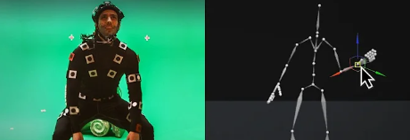
Role of Live Human Motion Tracking in MPC
Recording of the movement of humans and objects using different technologies
“Live Human Motion Tracking” : Applied specifically to humans in real time
Needs to “respond in a reasonable time or before a deadline, in a reliable manner” [18]
Mixed reality system enables avatar-mediated collaboration with natural hand motion [20]
Wall sized displays show awareness cues via key joints of interest [21]
CoMR-MoCap enhances rehearsal with MoCap suits and shared MR views [22]
[19]

Slide 37
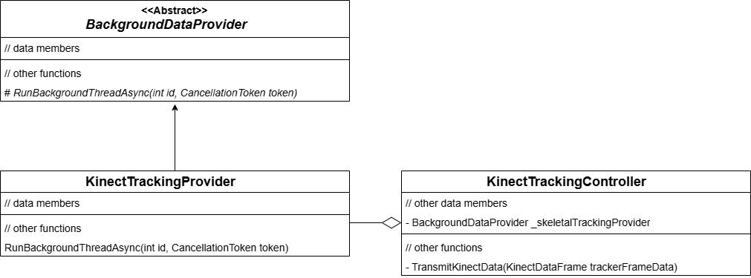
Pose Data Recording and Replay for Study Replicability
UML diagram showing existing class relationships for Kinect data handling.

Slide 38
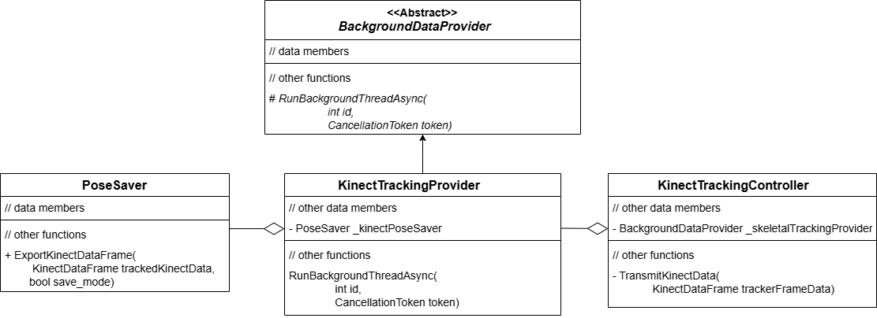
Pose Data Recording and Replay for Study Replicability
UML diagram showing added pose data saving functionality.

Slide 39
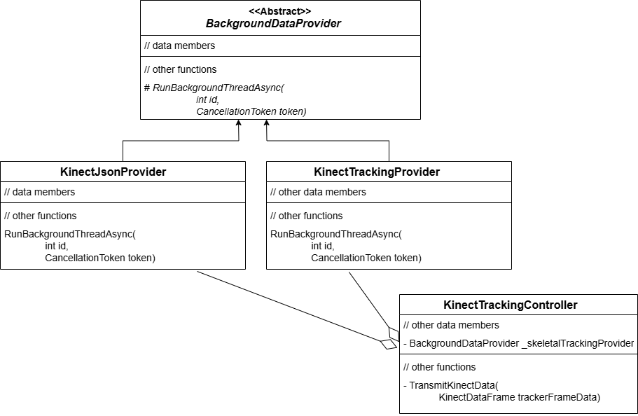
Pose Data Recording and Replay for Study Replicability
UML diagram showing added pose replay integration into existing system.

Slide 40
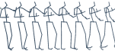


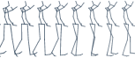


Autoregressive vs Non-Autoregressive Models
3D Motion Prediction Models
Autoregressive
Non Autoregressive
Accumulate errors over time
Bad at long term predictions
Hard to parallelize
Predict all frames in parallel
so on…
Less control over the upper limit of the number of frames being predicted

Slide 41

Design Choices
Dedicated inference server avoids resource contention and delays
Low-level sockets used for faster server communication
NAR model chosen for lower latency and workflow compatibility
Notes:
- Next I briefly talk about the key design considerations that guide the architecture and implementation of the integration.- The pose prediction model could be executed locally on the same machine as either the "KinectServer" or the "HololensClient", but this approach introduces significant limitations in terms of flexibility and performance. Resource contention between these components could lead to delays, reducing the system’s overall responsiveness and affecting the user experience. To avoid these issues and maintain optimal performance, the decision was made to implement a dedicated inference server for the pose prediction model.- With the decision to implement an inference server made, there are several methods available for enabling communication between the inference server and the other components. In order to keep system latency as low as possible, it was decided to utilize low-level sockets for communication instead of using high-level frameworks, which while convenient and simplify development, often introduce internal processing that can add hidden delays. - And finally, the decision to use a NAR model was based on prior research, which highlighted significant latency issues with the Autoregressive model evaluated in that work, making it unsuitable for integration into this system. Additionally, attempting to optimize the auto-regressive model was deemed unnecessary, as it generates only one frame per inference call, rather than a series of predicted frames. This behavior did not align well with the system’s workflow design.

Slide 42
Preprocessor and Postprocessor
Kinect and pose prediction model use different joint hierarchies
Model : 18 Joints; Kinect : 32 Joints = requires mapping
Kinect data inverted and joints laterally inverted for Unity compatibility
Preprocessor also standardizes data to pelvis-relative joint positions
Postprocessor converts SMPL data to Kinect format, filling gaps

Slide 43
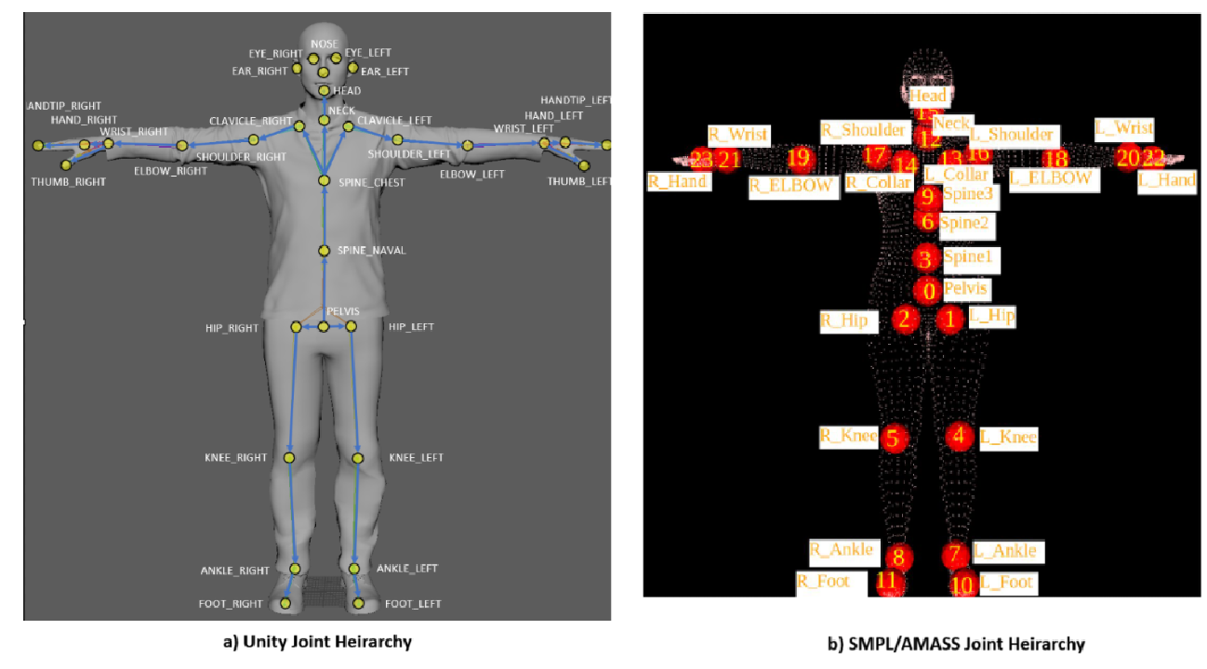
Kinect vs SMPL/AMASS joint hierarchy.
Kinect Joint Hierarchy
SMPL/AMASS Joint Hierarchy

Slide 44
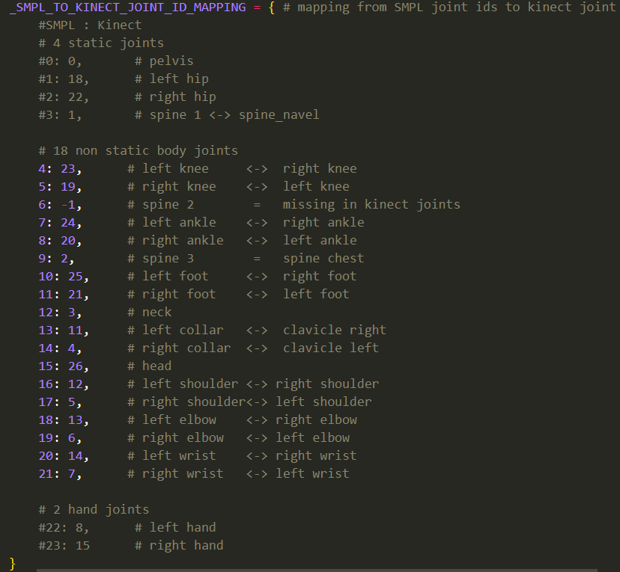
Mapping from SMPL Joint ids to Kinect Joint ids

Slide 45
Challenges Faced and Solutions
Testing delayed by parallel Unity instance coordination
Modified “HololensClient” reduced Unity instances for testing
Symlinked folders synchronized Unity projects
Integration required HCI, deep learning, and networking expertise
Cross-disciplinary learning enabled integration progress

Slide 46
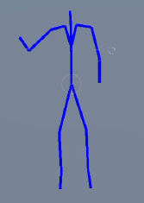
How was Visualization Done?
Initial attempt to animate a skinned mesh humanoid avatar
Issue with bone length mismatch causing distorted animations
Stick-figure avatar chosen for simpler and adaptable visualization of predicted poses

Slide 47
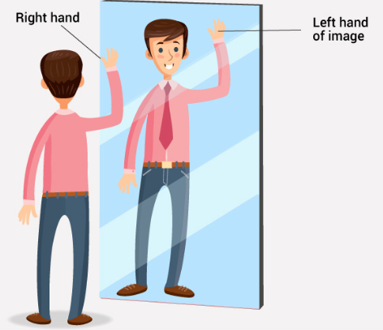
Visualization Results
Visual verification of integrated system important
Incorrect joint placement on “HololensClient”
Visualization revealed transformation issue
Lateral inversion fixed predictions
Visualization ensured correct functionality of the integrated system

